Slide 1
Cyber Seeds for Superfast Engineering Design
A presentation for the Northern Ireland Science Festival 2026
Innovation in Action: Engineering Research Showcase 13th February 2026
Professor Mark Price
Professor of Aeronautics, Queen’s University Belfast, Mechanical and Aerospace Engineering
EPSRC Fellow in Engineering Design

Slide 3
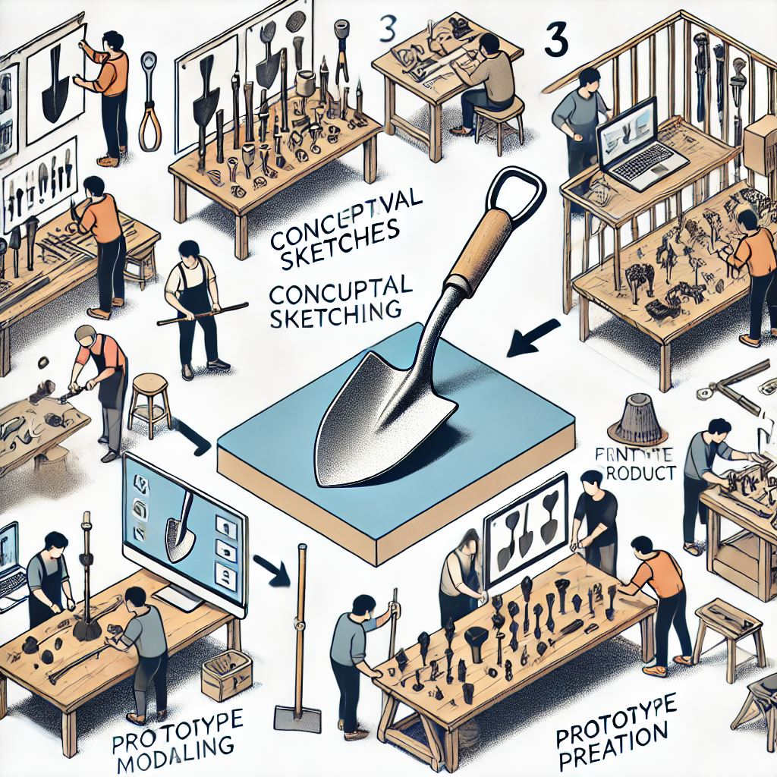

Design is:
the process of using creativity to solve problems and shape ideas into practical solutions
(The Design Council)
Note the AI generated text!
So many spelling mistakes!!!

Slide 4
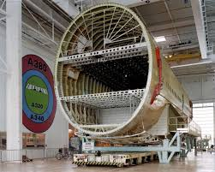
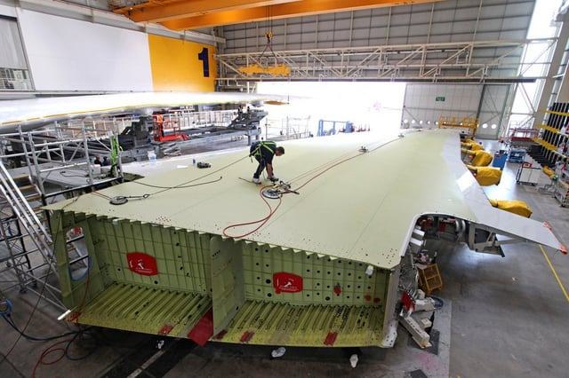
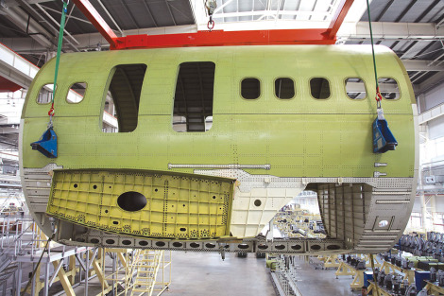
Airbus A380
4 million parts
1500 companies
30 countries

Slide 5
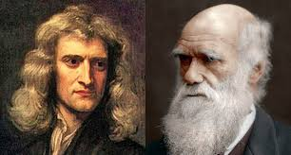
Isaac Newton
Charles Darwin

Slide 6

At the core of all this is DNA - the genes of life itself!
These are the instructions for how every plant and animal on the planet grows and develops into a living organism.

Slide 7
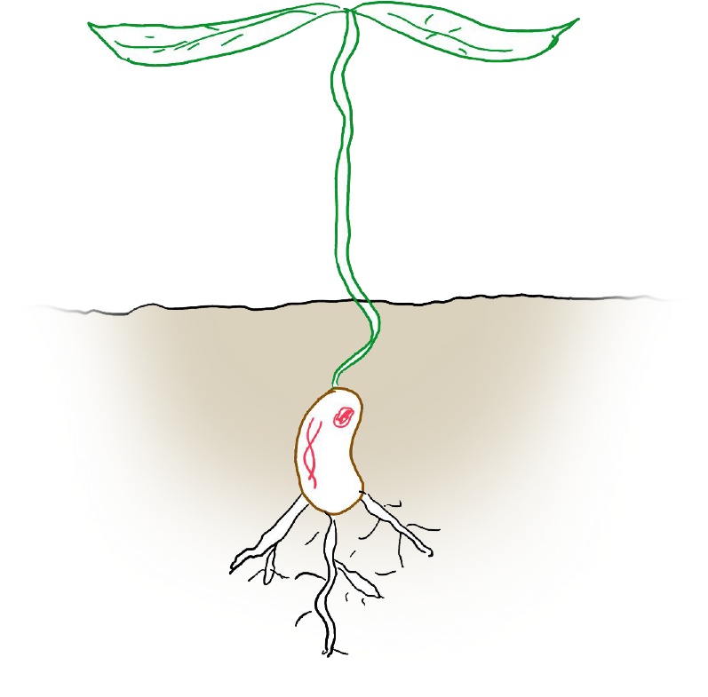

Slide 8
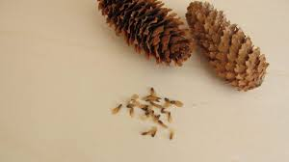
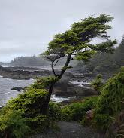
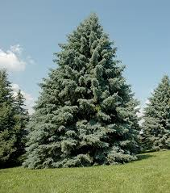
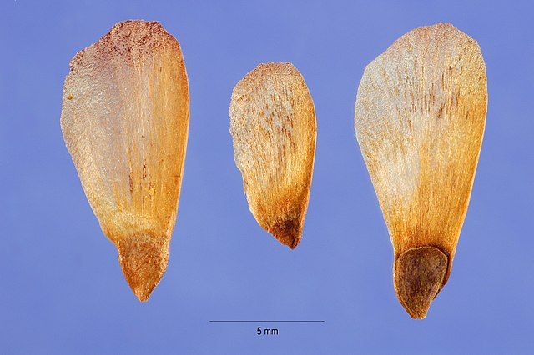

Slide 9
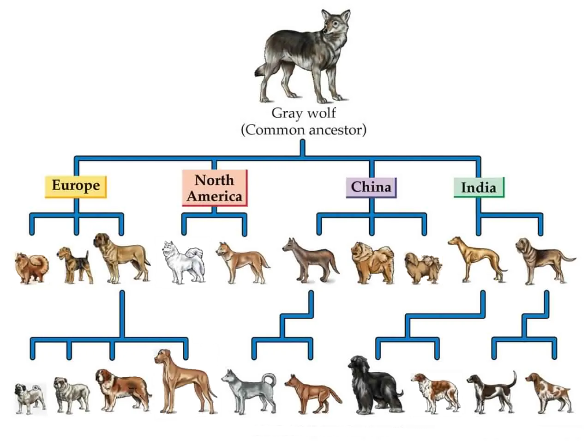

Slide 10

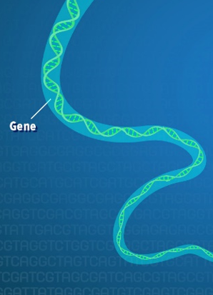
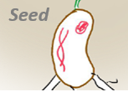
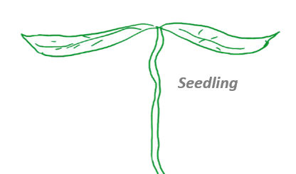
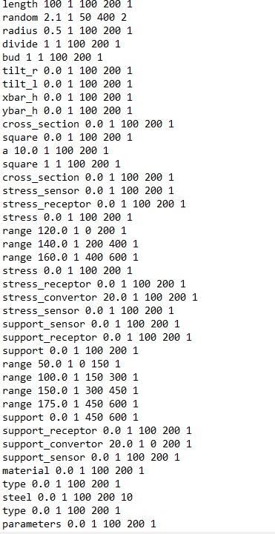
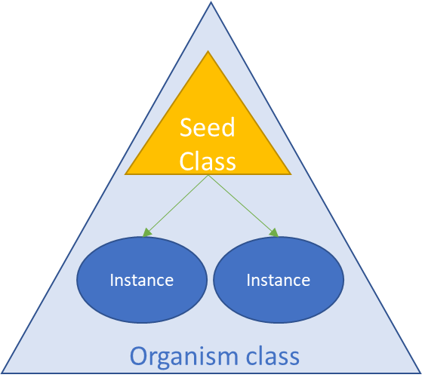
Organism
normal
Cell4
Initialise Cell Zero
Development
Cell3
Initialise Organism
centroid
Cell2
Cell1
Generative Design Tools

Slide 11
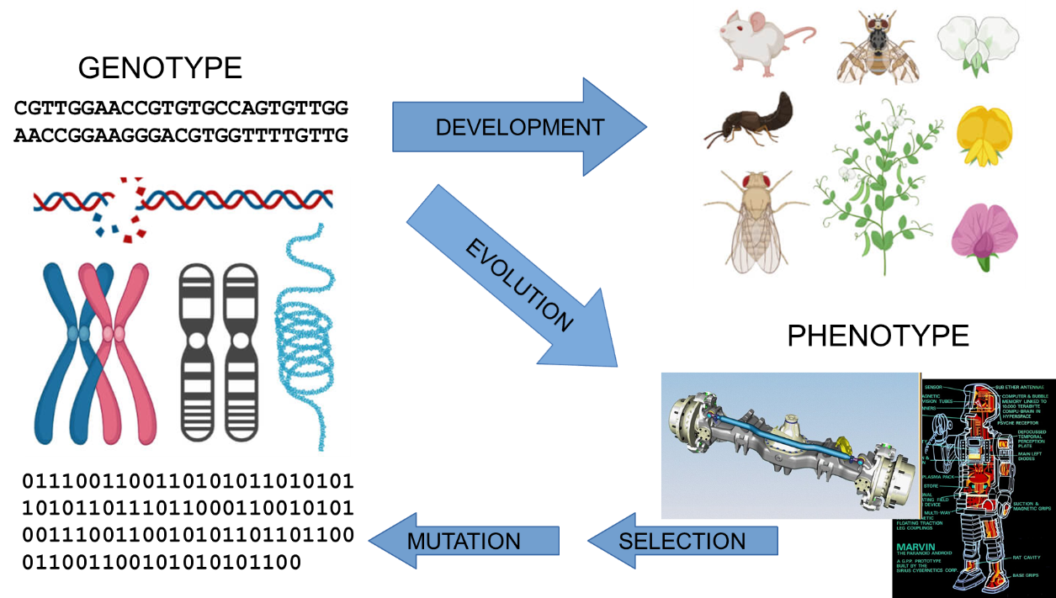

Slide 12
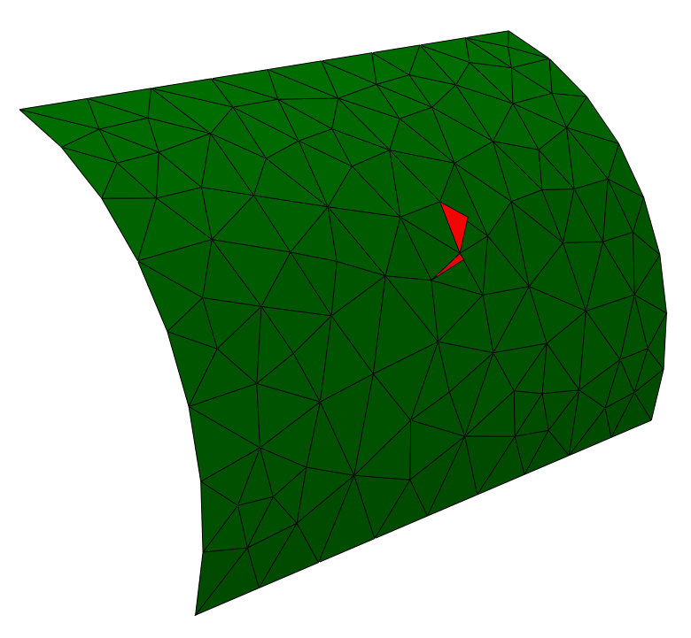
Start with a ‘seed’ – i.e. concept zero
Environment includes:
Loads
Constraints
Stress
Deflections
Symmetry
Objectives
Mass
Cost
Schedule
Gene Regulatory Network represented by an Artificial Neural Network (ANN)
Each triangle is a cell
Each cell has a set of genes i.e. its own gene regulatory network

Slide 13
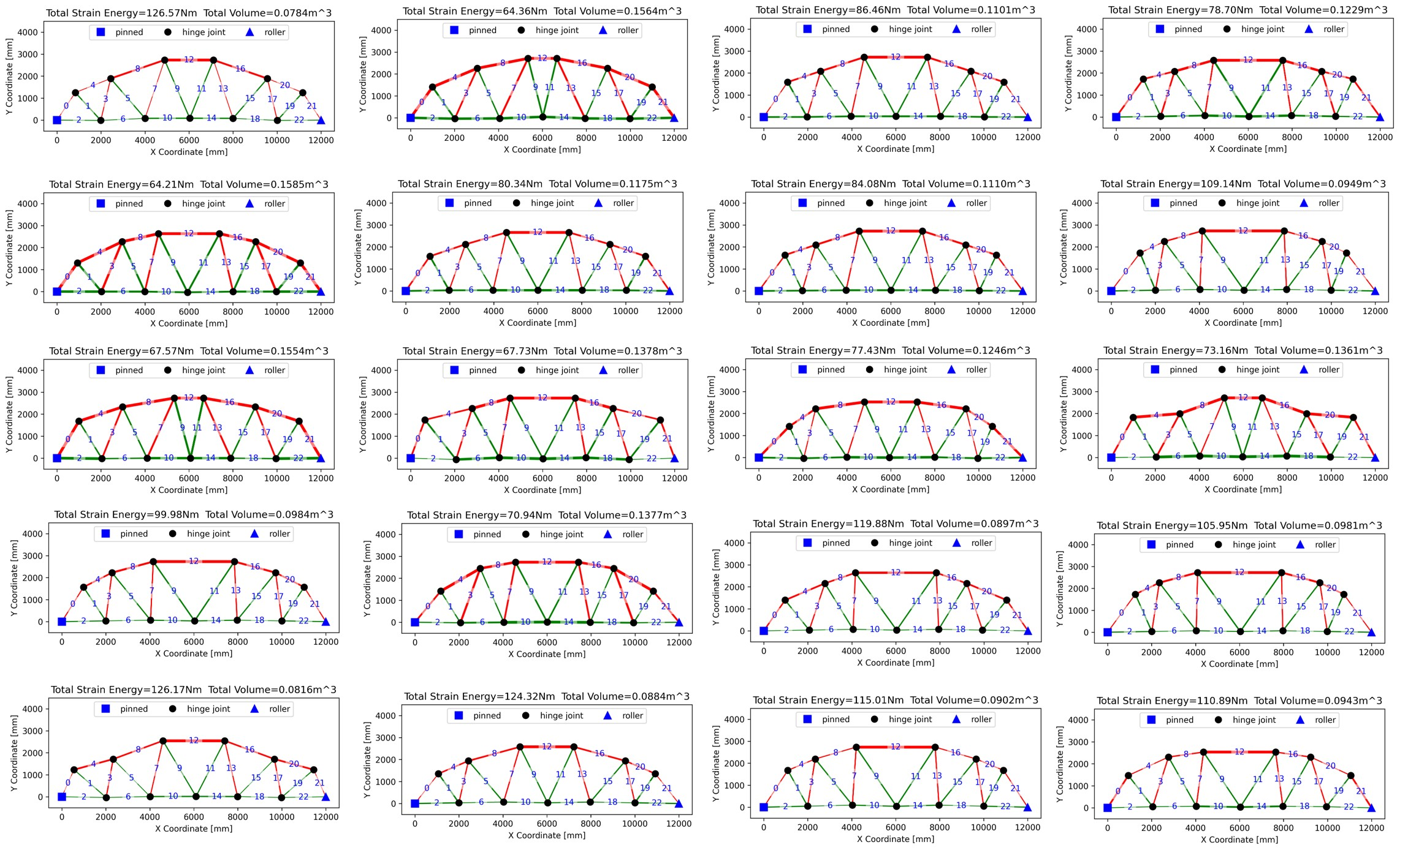
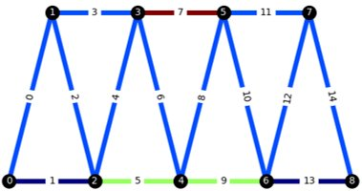
Explore lots of solutions…
Includes constraints, can include symmetry or shape and mass.

Slide 14
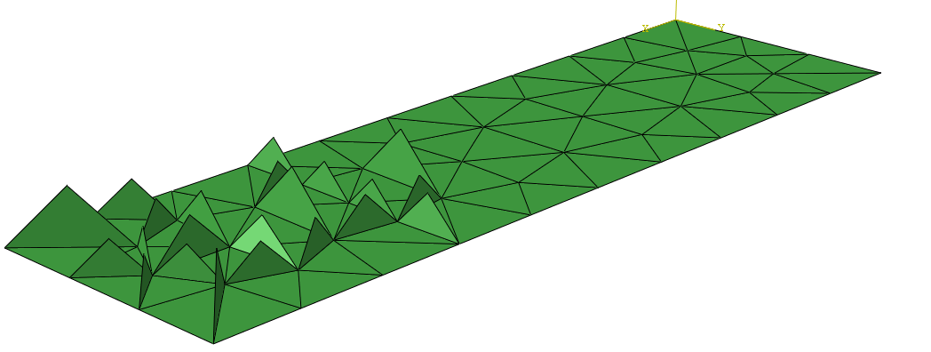
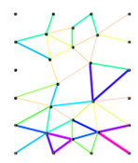
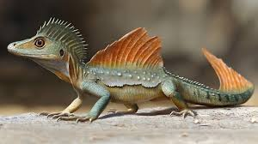
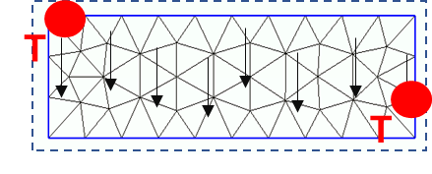
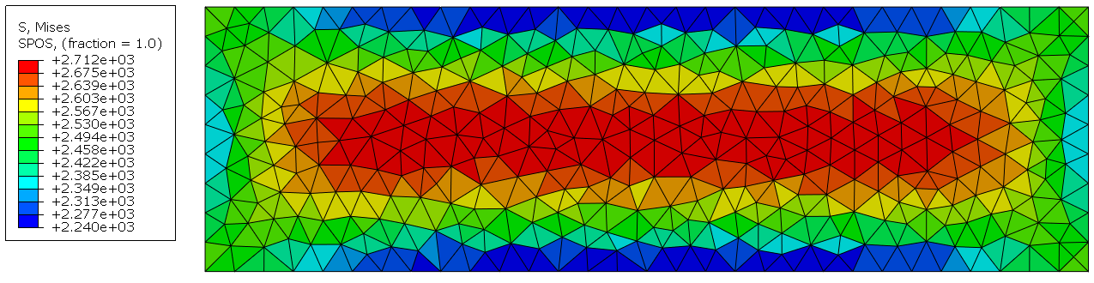
19:13:20
HFL*: 2.739
Vol: 6820
2D Heat Convection
2D Heat Conduction
2D Thermal Stresses
2D Pressure plates

Slide 15
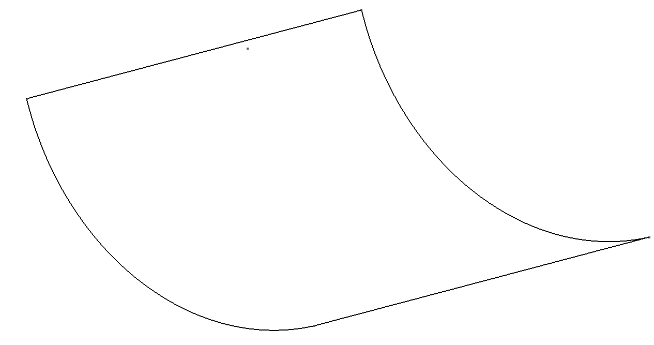
Curved Plate 1
Low Temp
High Temp
Objective:
Manage Heat across the plate
Network (RNEAT)
Input: Face Heat Flux
Output: Fin Addition

Slide 16
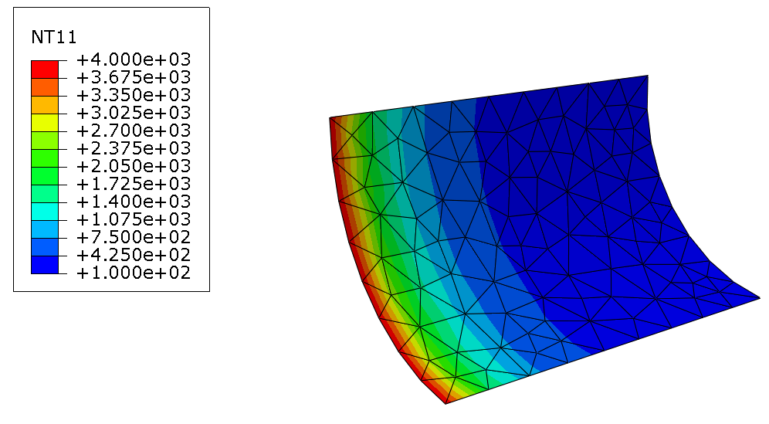

Slide 17
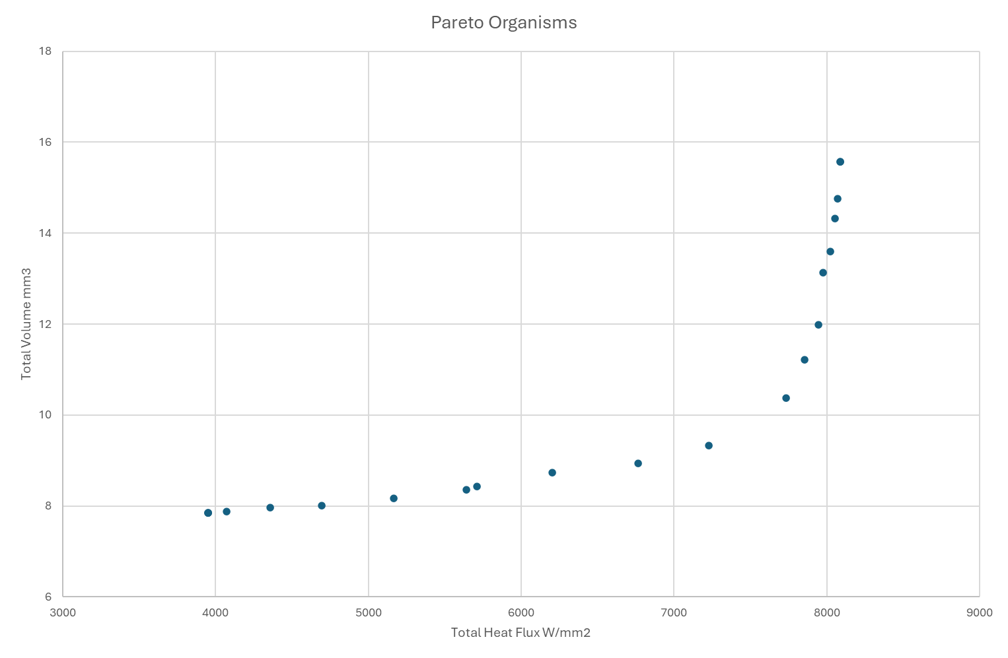
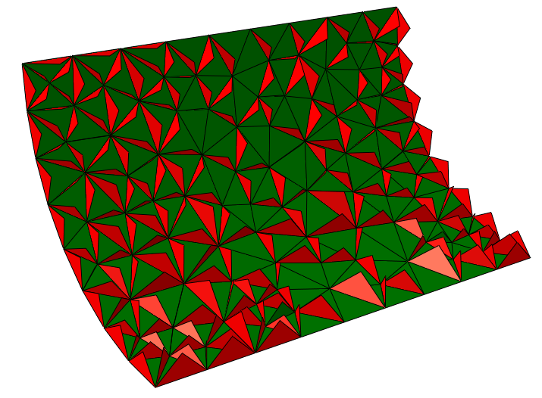
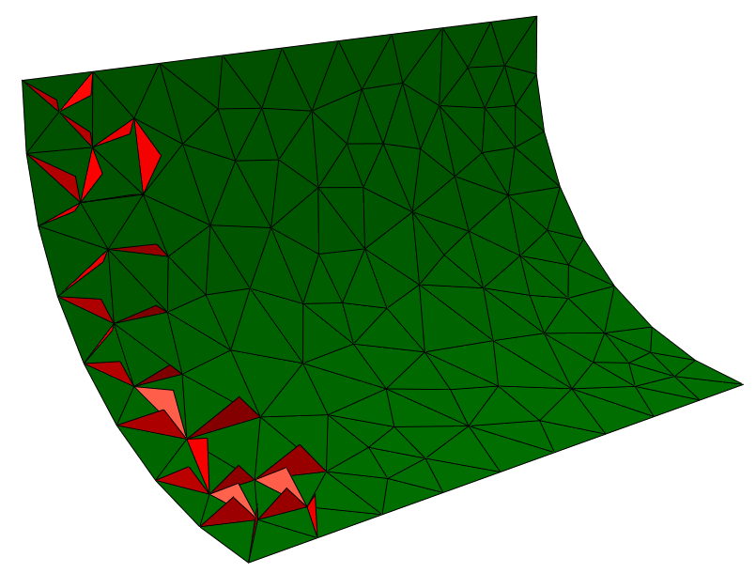
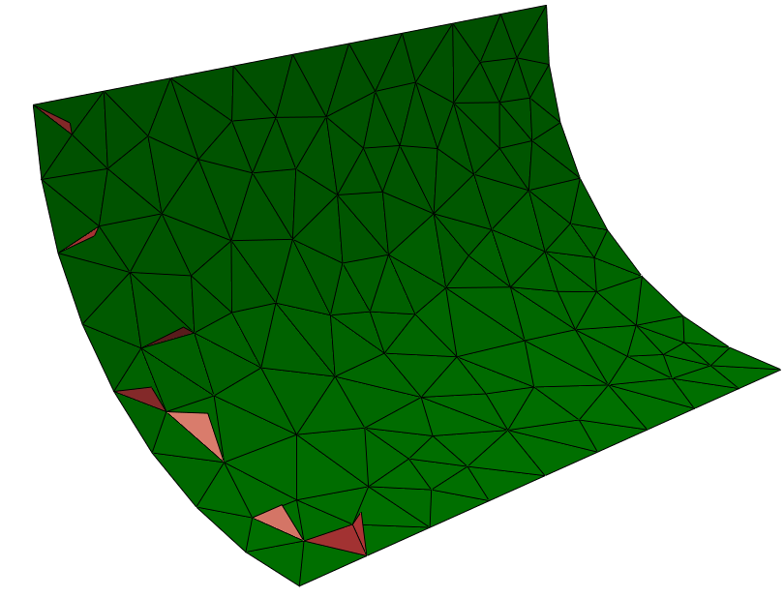
Pareto
Run for 100 generations:
225 mins
Fins develop and dissipate heat at key region

Slide 18
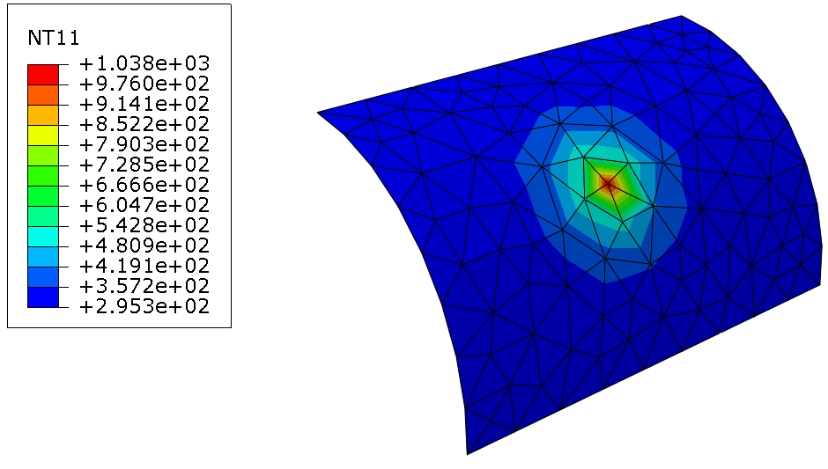

Slide 19
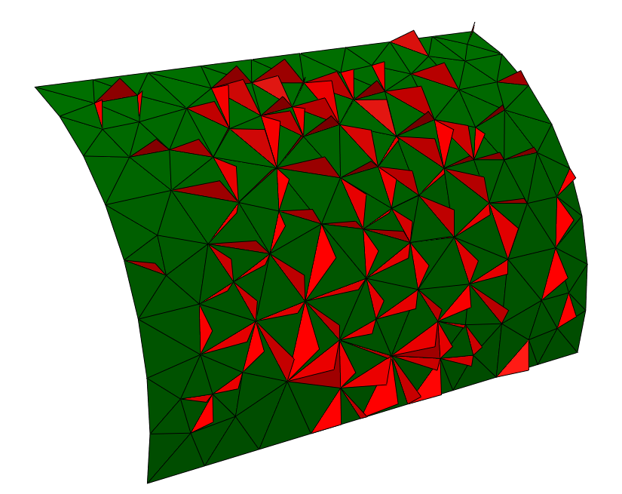
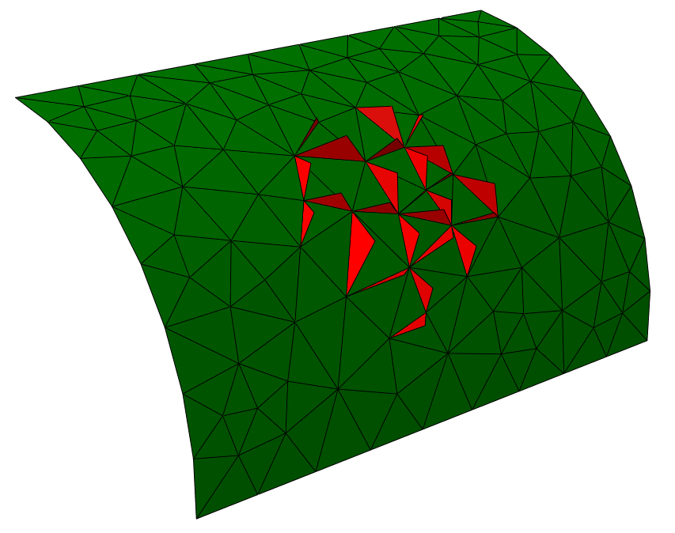
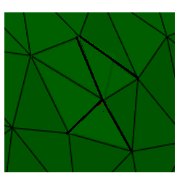
Seed
Just plant the seed & grow the solution directly – no evolution!
Superfast seed takes 5.4 seconds!
Speed up of 2,500 times
3 orders of magnitude.
Best Compromise between heat flux and structural mass.
NB fins are represented as triangular facets here but can be any shape in the real concept.
Evolution takes 45 minutes for 20 gens
Or 225 minutes for 100 gens.
14-8

Slide 20
Wing

Slide 21
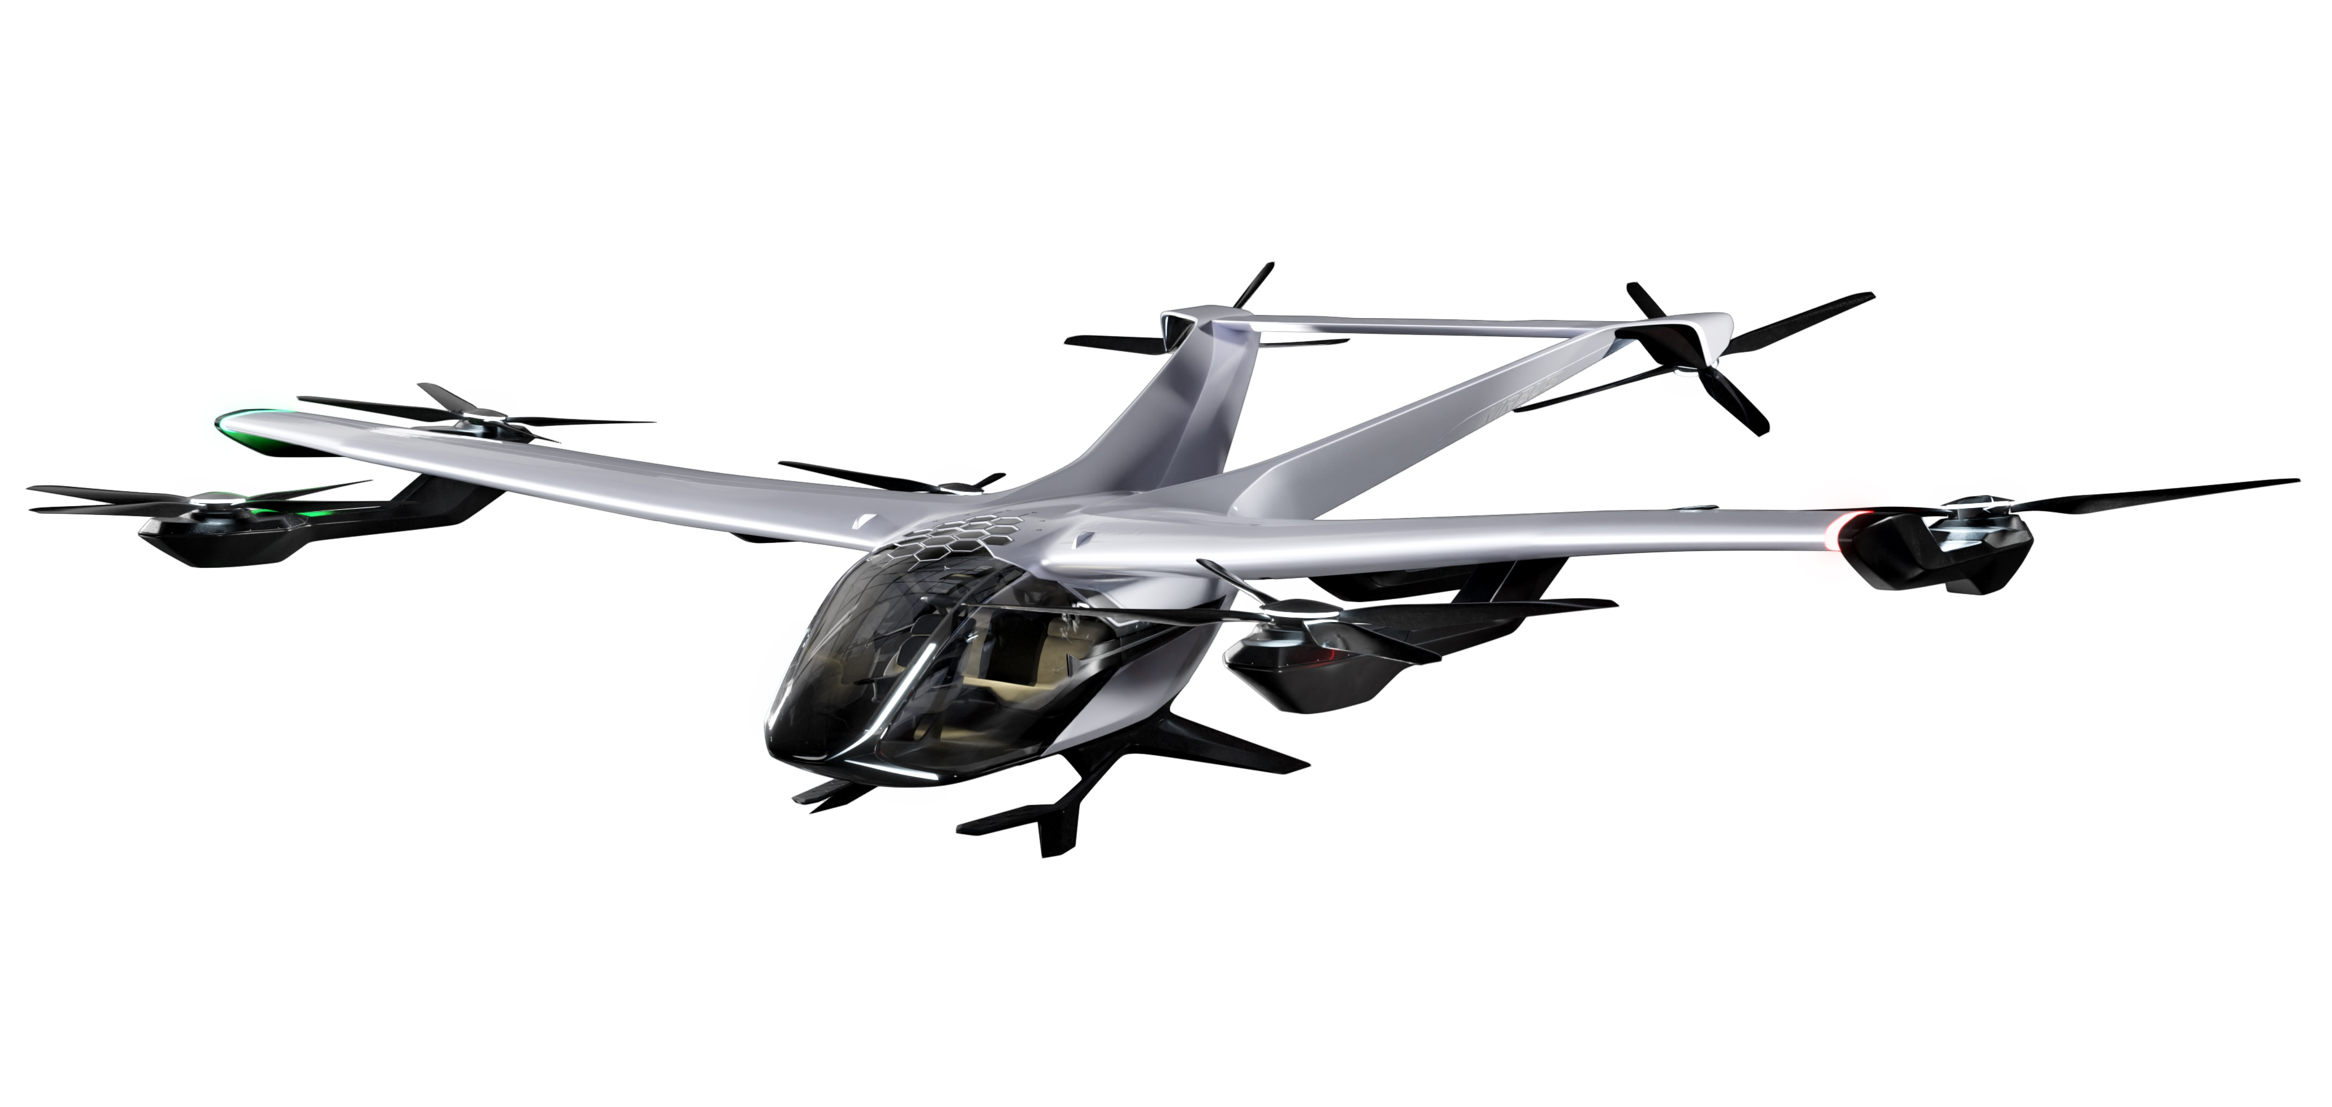
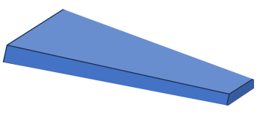
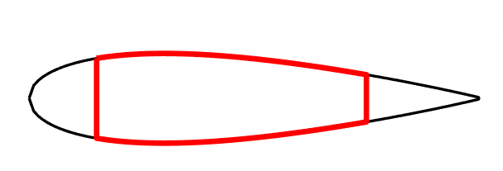
Wing Box Problem Outline
Use RIED software to evolve a range of viable wing box design solutions for the Airbus “City Airbus”.
Small aircraft to carry 4 people, total load of 2000kg (~20kN)
Wing-span of 8m (conventional wing)
NACA0020 aerofoil profile (equation-driven and symmetric)
Target weight: 100kg
Semi-span = 4m
$$y=5t\left(0.2969\sqrt{x}−0.126x−0.3516x^{2}+0.2483x^{3}−0.1015x^{4}\right)$$

Slide 22





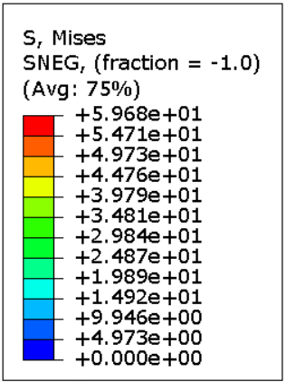
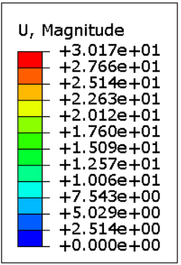
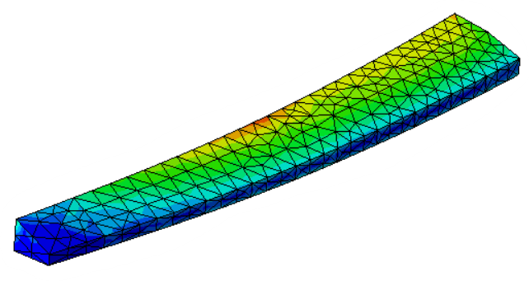
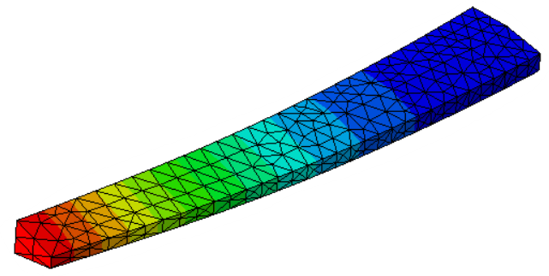
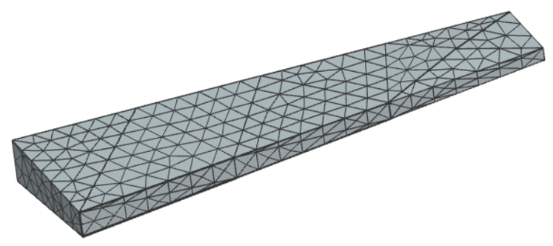
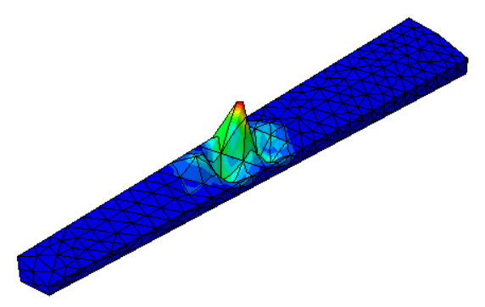
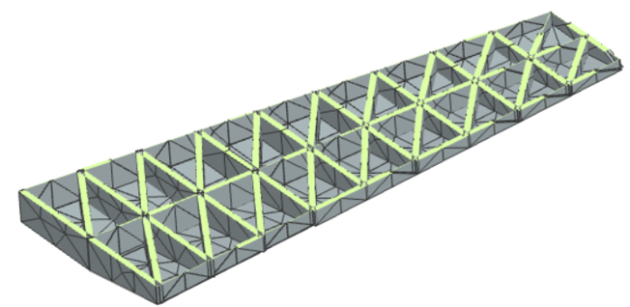

How is the “state” assessed?
Stress
[Static Analysis^{G,L}]
Specification
Deflection
[Static Analysis ^{G}]
Weight ^{G}
Elevated stress should lead to GRN promote thickening in this region
Critical Buckling Load
[Buckling Analysis ^{G}]
Manufacturing Cost
[Cost Model – Next Slide ^{G}]
Wing Lift / Drag
[Look-up Tables ^{G}]
Material cost
Machining cost
Assembly cost
^{G}: Global RIED Response
^{L}: Local RIED Response

Slide 23
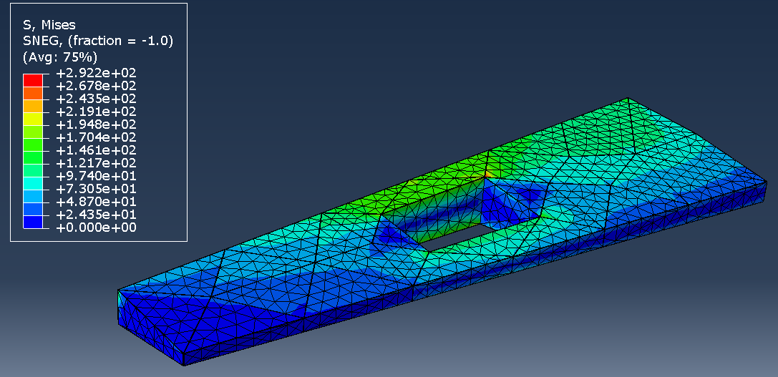
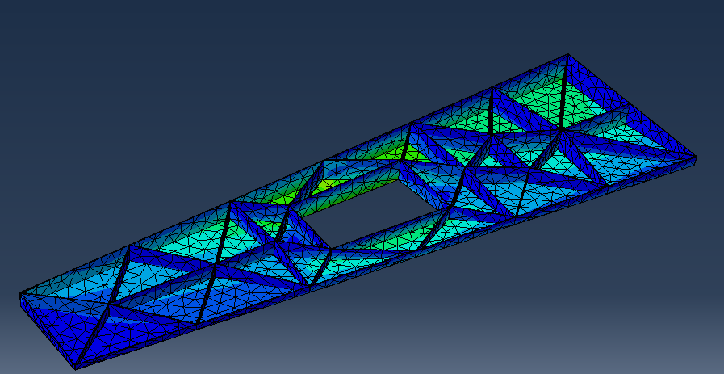
Speed up using superfast cyber seed is ~600
~2 days down to 5 minutes
i.e. 2 orders of magnitude!!

Slide 24
Trailer Design Challenge with AMIC NB AMIC is Norther Ireland’s Advanced Manufacturing Innovation Centre

Slide 25
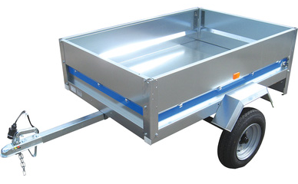
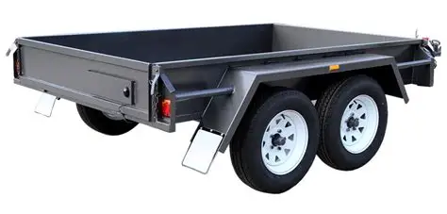
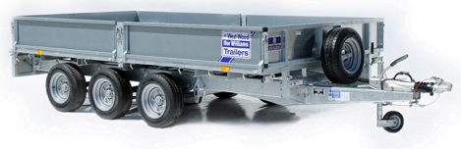
Project Brief
Create demonstration seedling for the design of a Trailer Chassis using the RIED Engine
Phase 1: Conventional Design Process
Phase 2: RIED Design Process
high degree of customisation in trailer market

Slide 26




Final CAD Geometry

Slide 27







Automated CAD Generation of Trailer Seedling Workflow
Chassis members are mirrored
Leaf spring generated based on trailer load and number of axles to calculate number of leaves
Plane created at ymax (top face trailer bed) and nodes joined (based on the applied force nodes from RIED GUI) in a 3rd sketch
COTS sub-assembly created with positional relationship for u-bolt plate to spring connection based on number of leaves
Structural Designer creates members for the lines in 3rd sketch
Trailer bed generated based on outer extents of the chassis frame

Slide 28



Automated CAD Generation of Trailer Seedling Workflow
Trailer frame and bed are joined with the COTS sub-assembly
*Equaliser and second set of axle, wheels, springs and brackets inserted when using dual-axle option

Slide 29





Demonstration of quick cost studies
Approximate cut-lists, weights, and costs and BoM’s generated for all 600 designs in just 35 seconds

Slide 30




Automated Generation of Quotation Document Workflow
Right click on a result
Compile and add in-house and COTS component costs
Parse inputs file for design constraint data
Parse geometry results files for cross-sections, volumes, and elements lengths
Identify Result Directory
CAD preview images appended to .pdf

Slide 31

Overview of Quotation Document Results
 |  | Quotation Turn Around Time
Double Axle (Conventional) |  | 1-2 weeks
Single Axle (RIED) |  | Less than 3 minutes
Double Axle (RIED) |  | Less than 3 minutes
With approx. 6 months development time, only about 12 quotations is break even!
Speed up per quote is ~6,000
i.e. 3 orders of magnitude!!

Slide 32


Chris Bosse, co-director of the Australian architecture agency Lava (Laboratory for Visionary Architecture).
The designs often appear similar to shapes and structures found in the natural world (Credit: Airbus) Ref bbc.co.uk/future

Slide 33

And remember…….
Imagination is the only weapon in the war against reality.” ― Lewis Carroll, Alice in Wonderland

Slide 34
Thank You!

