Slide 1

Babis Peteinarelis
Andy Tyrrell, Simon Hickinbotham
“Evolving the Adjacent Possible”

Slide 2
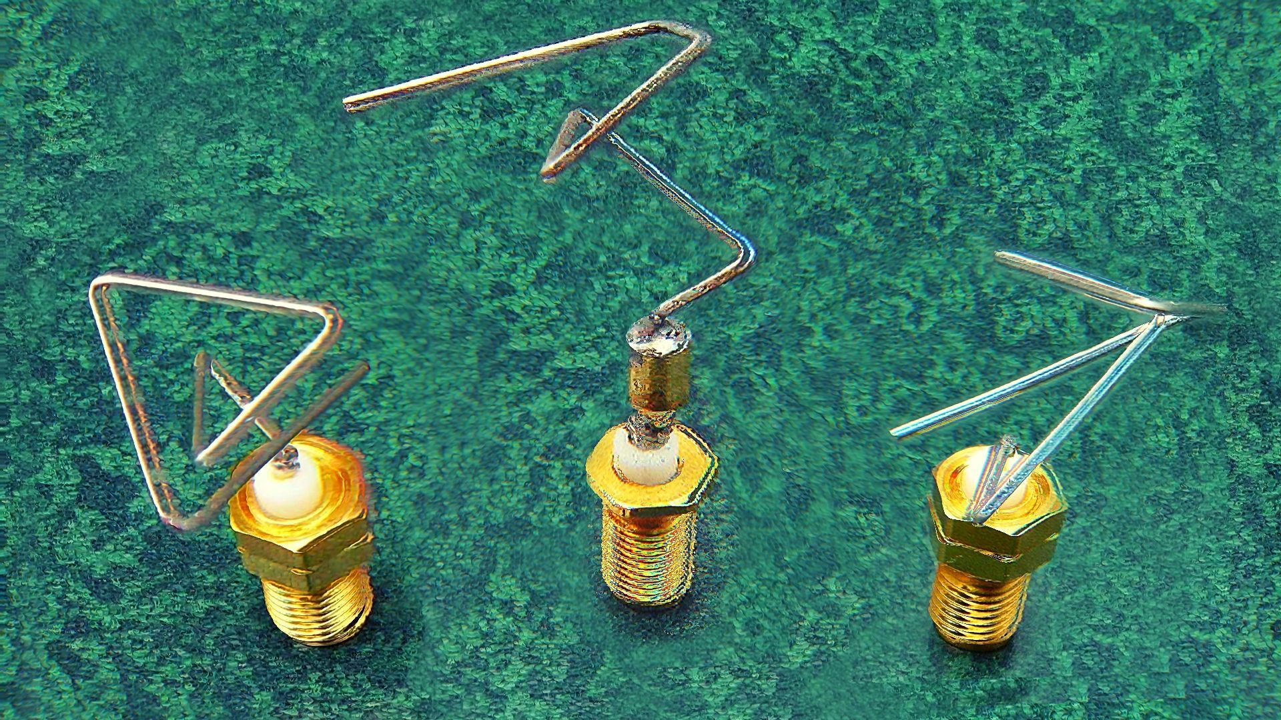
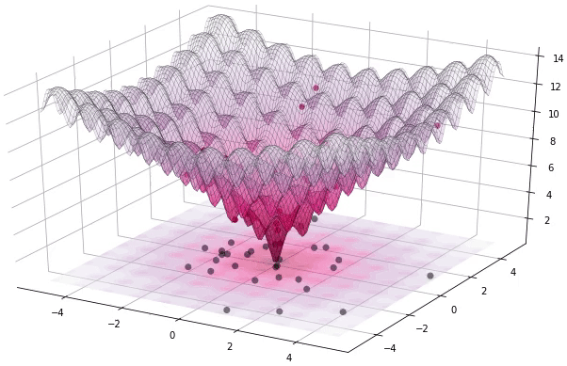
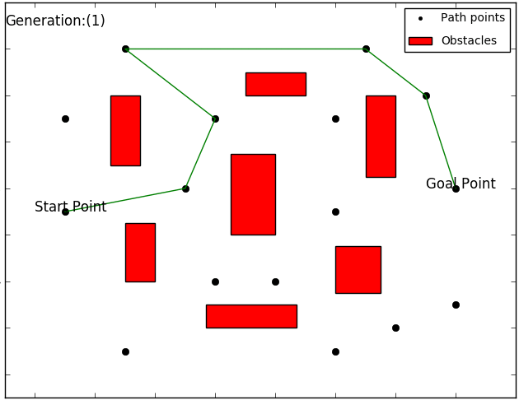
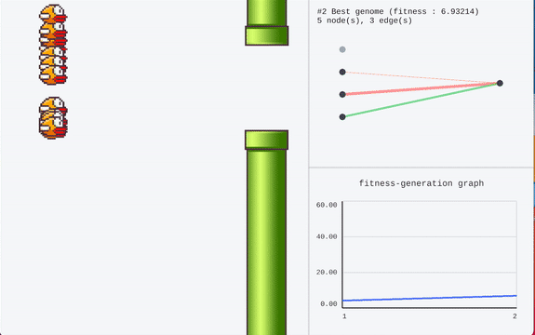
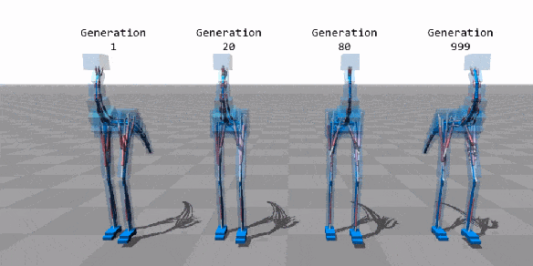
Evolutionary Algorithms:
Studying & Mimicking Evolution
Why evolution?
Final Design Tailored to Environment
No assumptions
Navigates infinite solutions
Diverse, Novel designs!

Slide 3
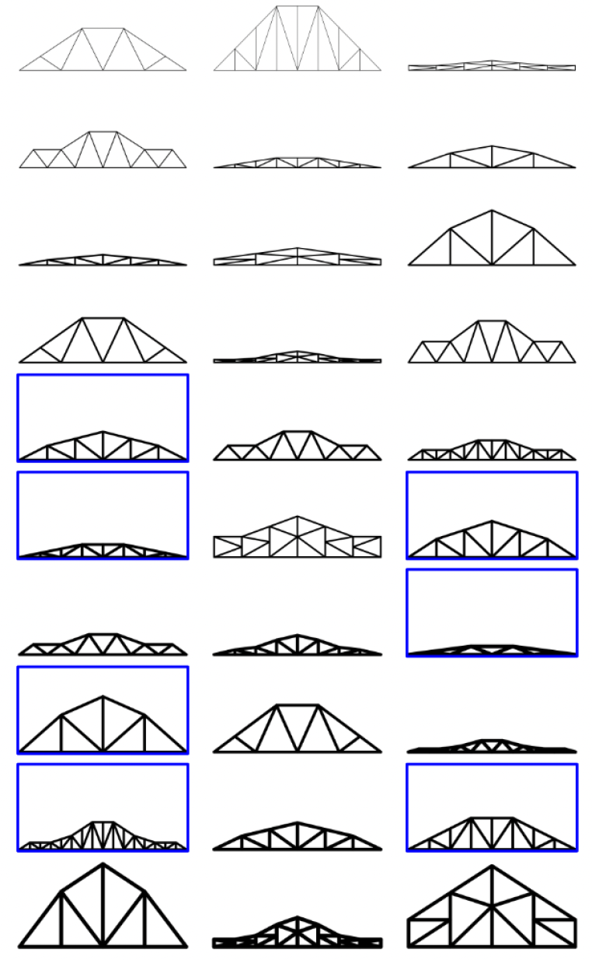
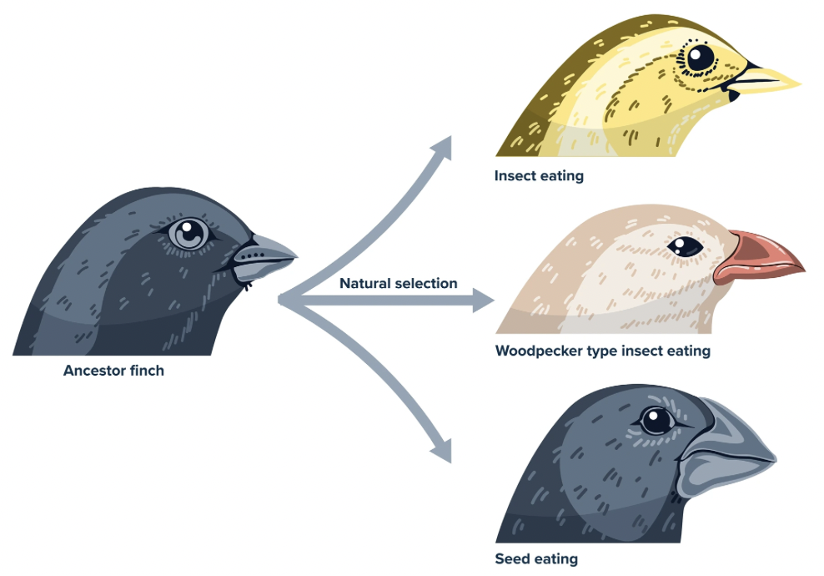
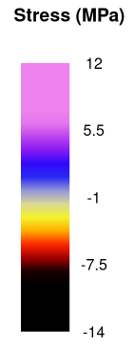



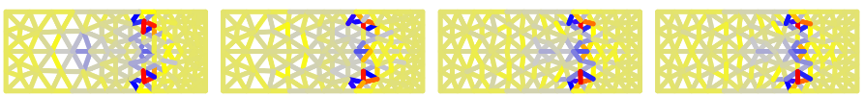


Leveraging Evolution for Design
How to evolve structure for novelty?
Devise Abstract Representation
Translate to Real Structures
Create Algorithm
Define Fitness
2500mm
Motor 8kg
Driver 80kg
Motor 8kg
1000mm
Battery 130kg
Can machines evolve…?

